Slide 1
Amazon food reviews clustering using K-Means, K-Means++ and Agglomerative clustering Algorithms
Rajashree Pethkar
Upasana Chaudhari

Slide 2
GOALS
Cluster data using k-means, k-means++ and agglomerative clustering
Visualize the clusters
Compare the results

Slide 3
How did we do it?
Preprocessed the data
Extracted features using TF-IDF
Implemented PCA to reduce the dimensions
Performed K-means , K-means ++, and Agglomerative clustering
Generated the output by plotting the clusters
Compared the results

Slide 4
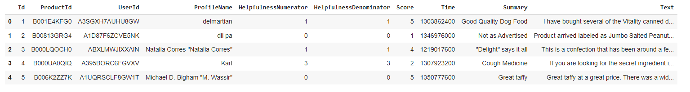
Data Snippet
Column Name | Description
ID | Row ID
Product id | Unique identifier for the product
UserId | Unique identifier for the user
ProfileName | Profile name of the user
HelpfulnessNumerator | Number of users who found the review helpful
HelpfulnessDenominator | Number of users who indicated whether they found the review helpful or not
Score | Rating between 1 and 5
Time | Timestamp for the review
Summary | Brief summary of the review
Text | Text of the review

Slide 5
Preprocessing the data
Converted the text to lowercase.
Removed punctuation i.e any non-alphanumeric characters in the text is removed.
Replaced occurrences of characters like /(){}\[\]\|@,;.with a space.
Removed occurrences of bad symbol. Eg- characters like #+_“
Removed digits.
Split the text into individual words, removes stop words using the STOPWORDS set, and joins the remaining words back into a single string.
Dropped unwanted columns.

Slide 6
Feature Extraction using TFIDF
TF-IDF stands for Term Frequency-Inverse Document Frequency. It is a numerical statistic used to evaluate the importance of a term (word) within a document.
TF-IDF vectorizer computes the TF-IDF value for each term (word) in each document.
It creates a matrix where each row represents a document, each column represents a term, and the cell values represent the TF-IDF scores.
The resulting TF-IDF matrix is a sparse matrix, serves as the feature representation of the documents for text clustering.

Slide 7
Implemented PCA
Principal Component Analysis (PCA) is a technique used to reduce the dimensionality of data while retaining the most important information.
Implemented PCA using sklearn library.

Slide 8
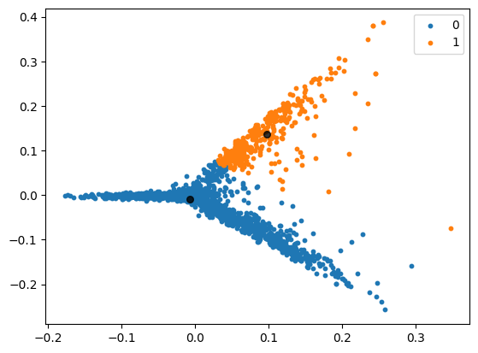
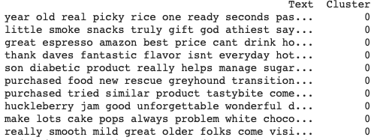
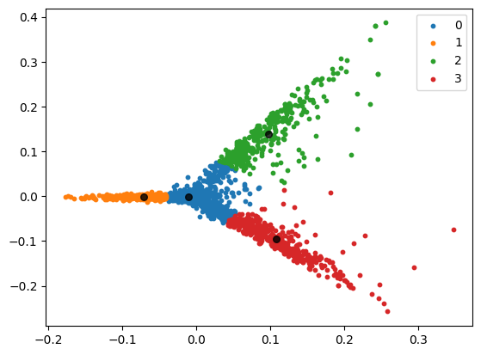
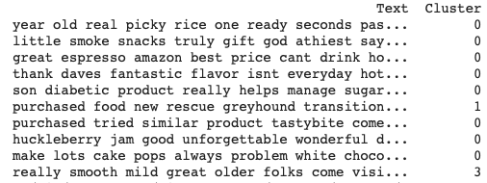
Kmeans and Kmeans++

Slide 9
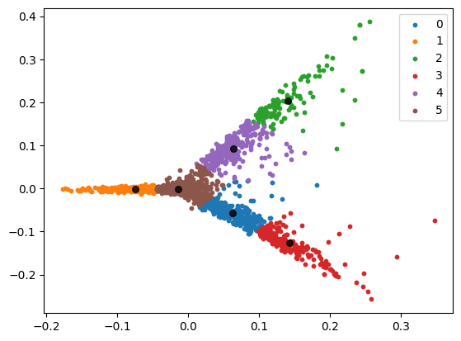
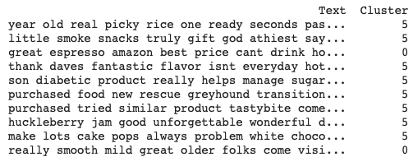
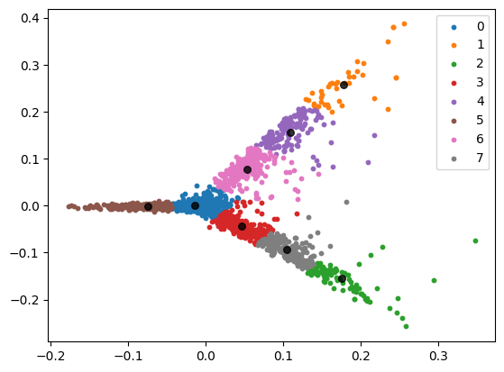
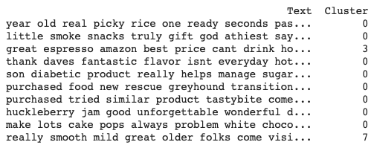
Kmeans and Kmeans++

Slide 10
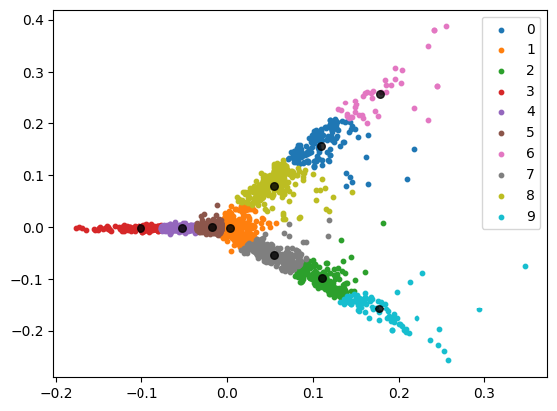
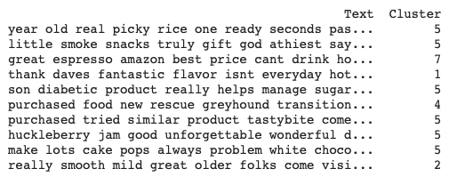
Kmeans and Kmeans++

Slide 11
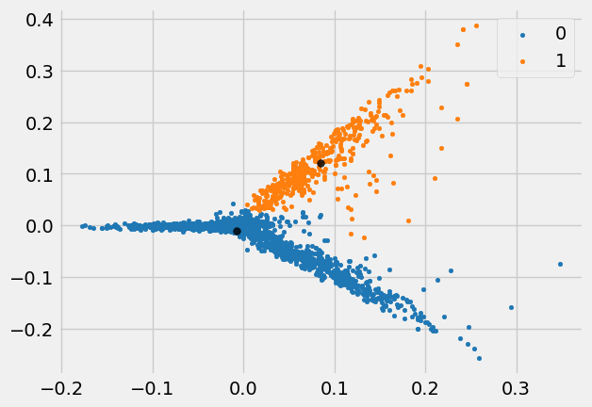
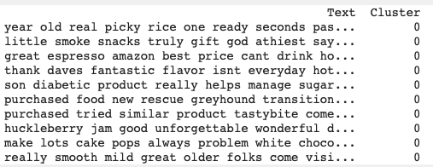
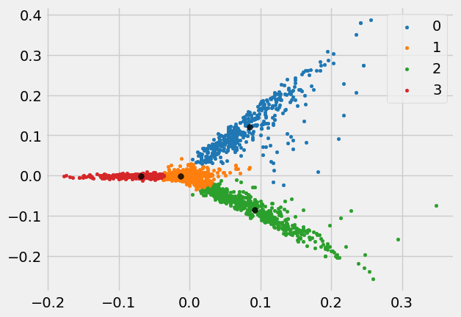
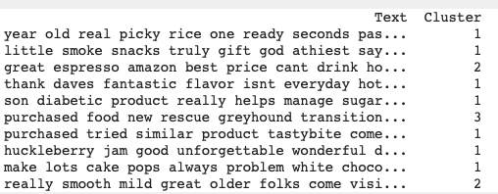
Agglomerative Clustering

Slide 12
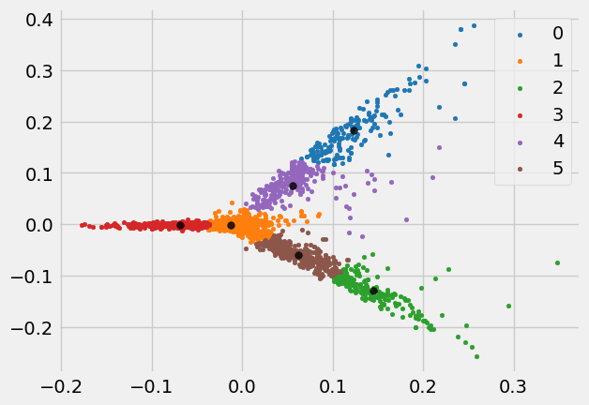
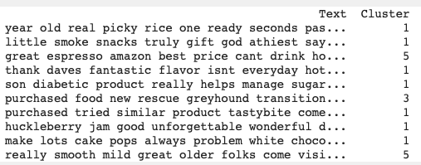
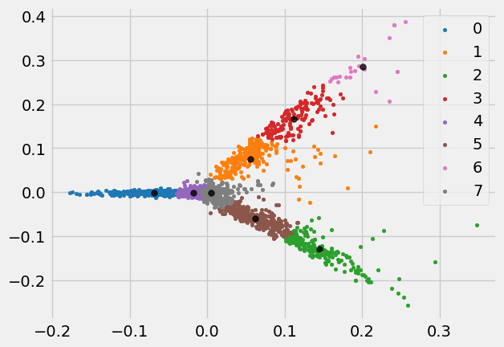
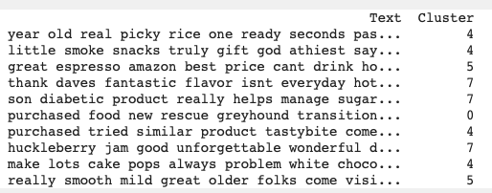
Agglomerative Clustering

Slide 13
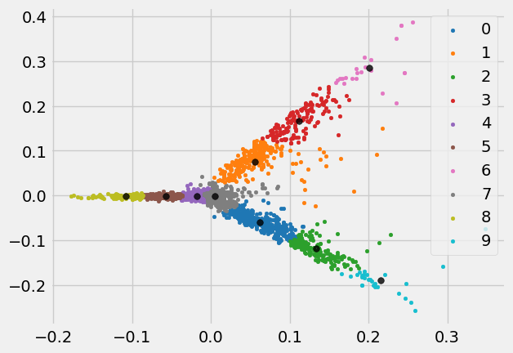
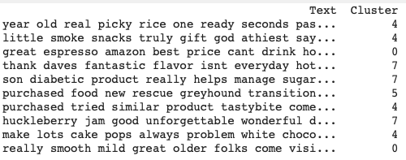
Agglomerative Clustering

Slide 14
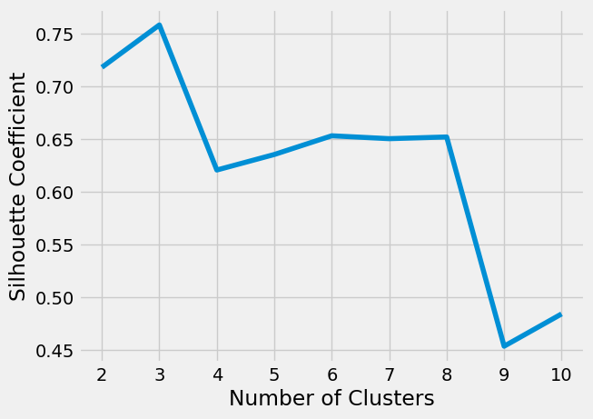
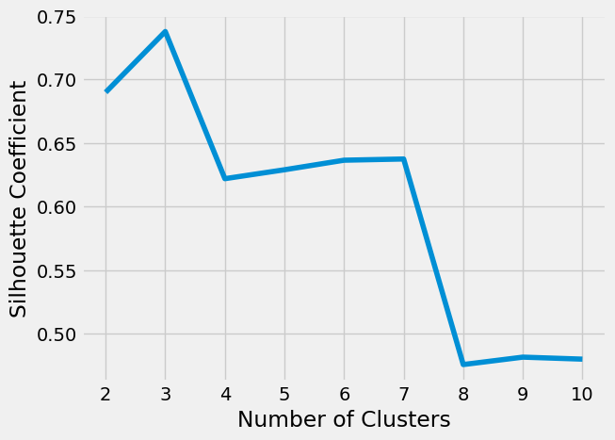
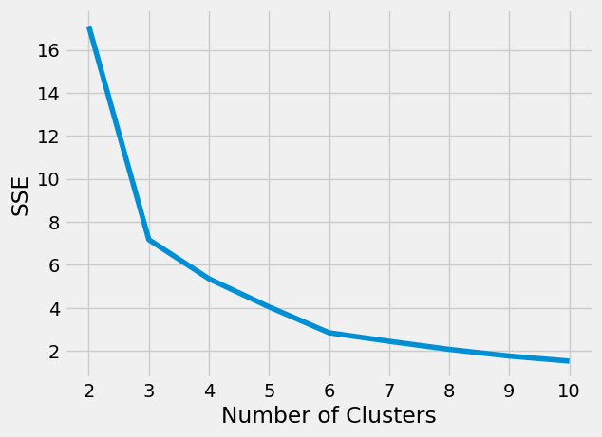

Evaluation Metrics
Kmeans
Agglomerative

Slide 15
THANK YOU

